Slide 1
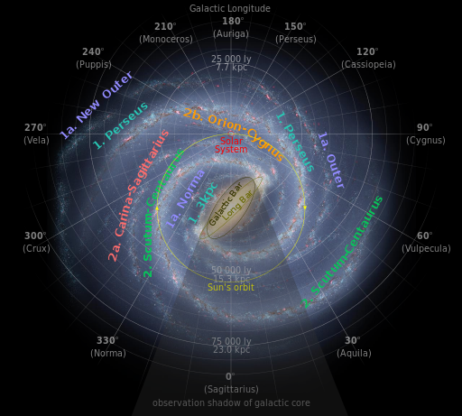
Deriving the Galactic Oort Constants from Observational Data
Shufan Xia
Advised by Karen Masters (Haverford)
& Zhaoyu Li (Shanghai Jiaotong University)

Slide 2
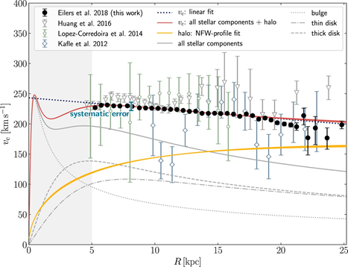
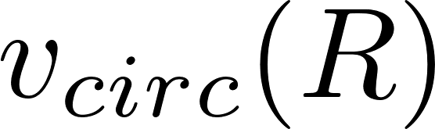
The Milky Way rotation curve tells us a lot about our Galaxy.
The red line shows the overall rotation curve
Differential rotation
MW potential
Mass distribution: existence of dark matters

Slide 3
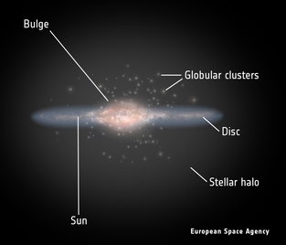
We have multiple methods to meaure the rotation curve, but it is hard due to observation constraints.
Farthest spacecraft
- Radial velocity of atomic hydrogen (HI) and CO emission (tangent point method); classical Cepheids; RR lyrae.
- Observation constraints because of our location in the MW:
1) co-moving with MW;
2) we can only see one side of the MW;
3) dust and gas block our line of sight.
16 kpc
8 kpc

Slide 4
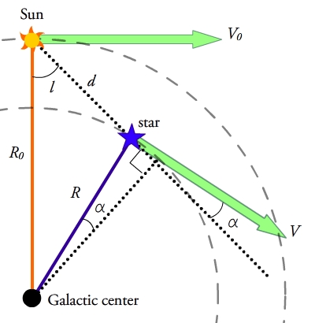
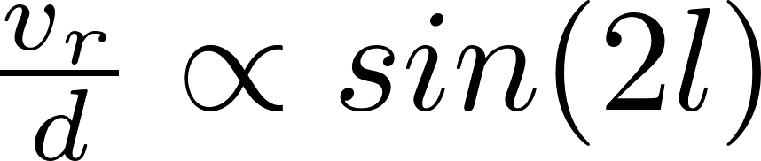
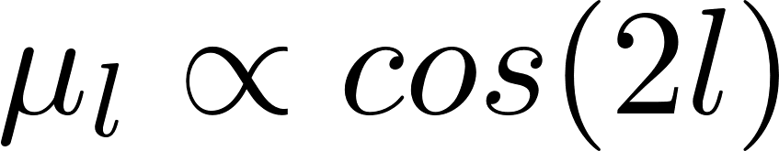
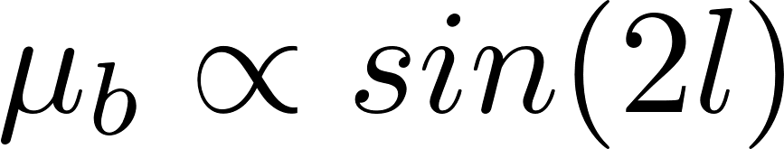
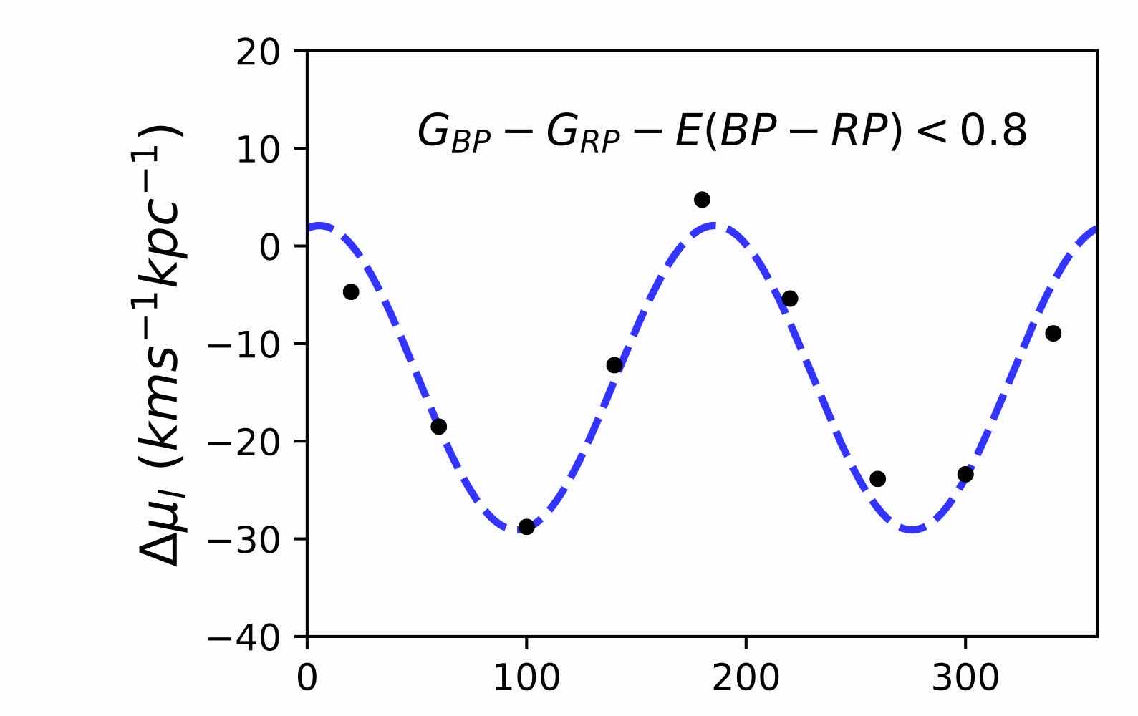
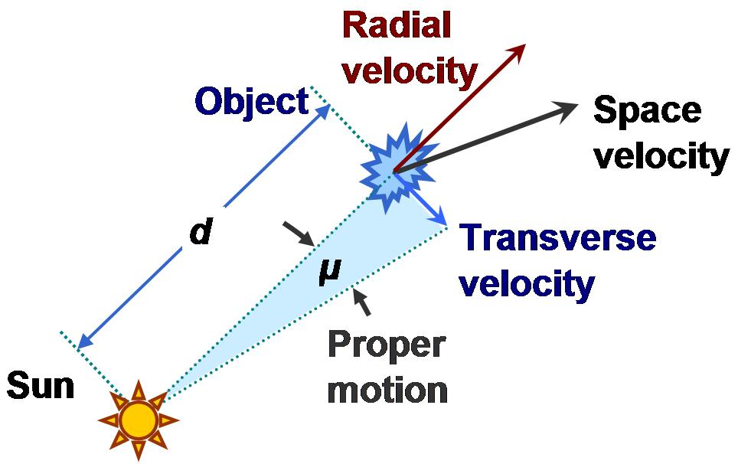

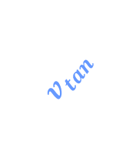


The Oort Constants are local traceres of the Galactic kinematics.
The Oort Constants describe the local rotation in the solar vicinity:
Assume circular orbits and axis-symmetric potential
Expanding local velocity field for radial velocity($v_{r}$) and proper motion ($μ=\frac{v_{tan}}{d}$ ):
The full equations need 4 constants:
A -- azimuthal shearing, B-- vorticity,
C -- radial shearing, K-- divergence
Sun’s non-circular motion adds single
sine (and cosine) terms
$d=1/parallax( π$)
$$v_{los}$$
$$v_{tan}$$

Slide 5
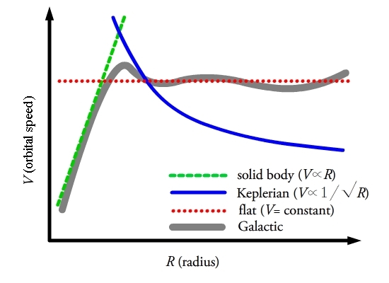
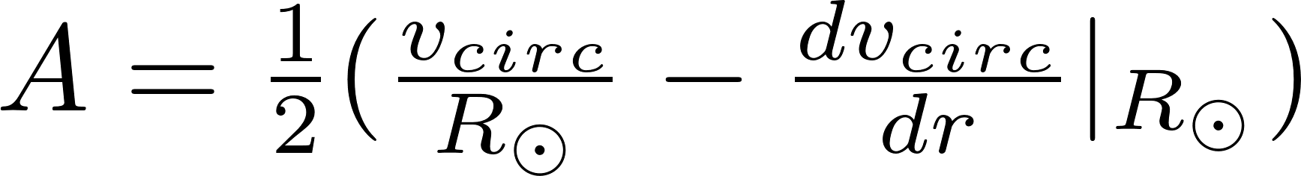
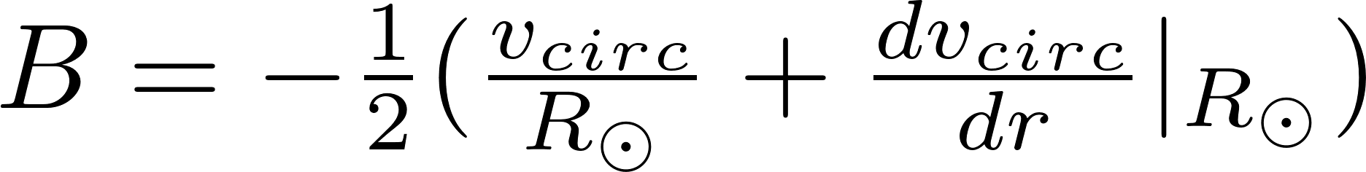
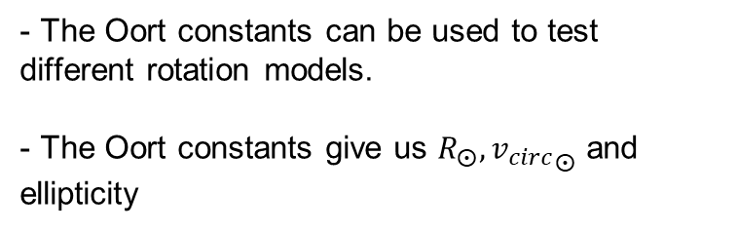
The Oort constants and the MW rotation curve
- The slope of the local rotation curve can be written in terms of A and B.
Slope = -(A+B)
- The Oort constants can be used to test different rotation models.
- The Oort constants give us $R_{⨀}, {v_{circ}}_{⨀}$ and ellipticity

Slide 6
Constraints and influencing factors
Requires a massive proper motion catalogue for stars just distant enough and enough sky coverage.
Non-axisymmetric potential adds ellipticity to circular orbits.
Spiral arms add streaming motions and random motions.
Systematic error from non uniform distribution of parallax over longitudinal.

Slide 7
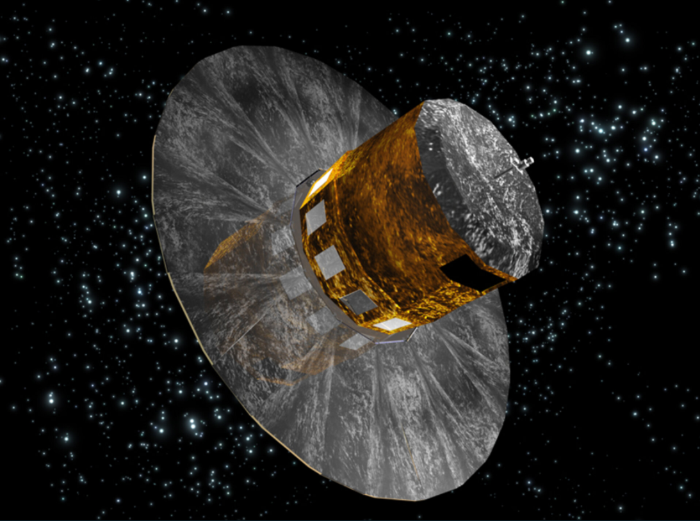
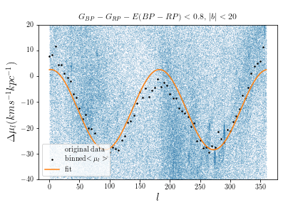
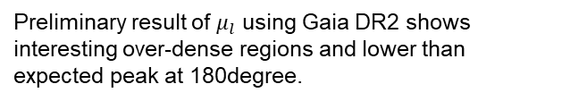
Gaia DR 2 has proper motion measurements of nearly 1.7 billion stars
- Gaia makes it possible to look at fine local kinematic features
- Previous studies of Oort constants: radial velocity unused, patterns due to individual sample not included, sampling limits without much justification.
Preliminary result of $μ_{l}$ using Gaia DR2 shows interesting over-dense regions and lower than expected peak at 180degree.
*This December, Gaia EDR3, >1.8 billion stars

Slide 8
My plan
Goal:
What is the best sample of stars to carry out Oort constants derivation
Determine the deviation of Gaia observational results from theoretical model
How:
Derive Oort constants from Gaia DR2
Study the overdense regions and deviation from double sine curves
Use a toy model simulation to find at what latitude and parallax the Oort constants analysis is appropriate

Slide 9
Summary
Rotation curve tells us about the potential and mass distribution of the MW.
It is not easy to measure rotation curve.
Oort constants describe local rotation motion, but can be used to test rotation models and determine other galactic parameters.
Gaia makes it possible to determine Oort constants to higher precision
I wil derive the Oort constants from Gaia data and examine the sampling limits.

Slide 10

Acknowledgement
Prof. Karen Masters
Dr. Zhaoyu Li and Dr. Juntai Shen from Shanghaijiaotong Univeristy

Slide 11
Image Sources
Artist’s impression of the Milky Way: NASA/JPL-Caltech/R. Hurt (SSC/Caltech), https://solarsystem.nasa.gov/resources/285/the-milky-way-galaxy/
Artist’s impression of Gaia:European Space Agenecy, https://www.esa.int/ESA_Multimedia/Images/2006/05/Artist_s_impression_of_the_Gaia_satellite
Rotation curve: Eilers, A.-C., Hogg, D. W., Rix, H.-W., & Ness, M. K.2019, ApJ, 871, 120, doi: 10.3847/1538-4357/aaf648
Galactic coordinate: COSMOS - The SAO Encyclopedia of Astronomy
Geometry of a differentially rotating disc: Wikipedia – Oort constants
Different rotation curve: Wikipedia - Oort constants
Proper motion: Wikipedia – proper motion
Longitude proper motion: Li, C., Zhao, G., & Yang, C. 2019, ApJ, 872, 205, doi: 10.3847/1538-4357/ab0104

Slide 12
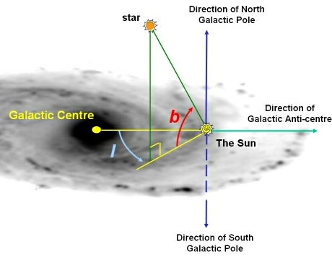
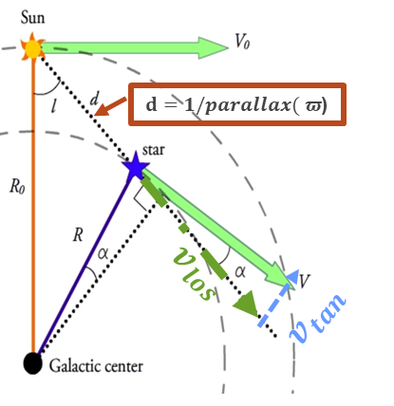
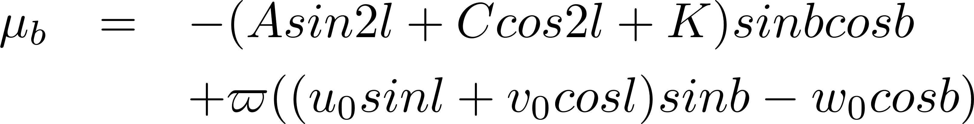
Key equations
Rotational velocity and radial velocity:
Correction for Sun’s random motion (u0,v0,w0 ) deviated from circular orbit

